Slide 1

Team WebPros
Web Programming 4370 group project
Jeopardy!

Slide 2
Jeopardy!
For our group project we made a Jeopardy style game to play online.
Team WebPros is:
Jay Limbasia: Lead programmer, Designer, Tester
Farhana Chadni: Programmer, Home Page Designer, Tester
Patrick Davis: Team leader, Programmer, Tester

Slide 3
Our game will allow the player to select from different categories with varying levels of values and difficulty.
It was created with HTML, PHP, and CSS files.

Slide 4
Scrum Framework
Using this type of framework allowed us as teammates to work together in a more productive way
We were able to respond to changes and new problems that arose as we worked through the project.
We communicated through Discord and in person brainstorming sessions.
We had clear communication and that helped to power through the challenges we encountered.

Slide 5
Home Page

Slide 6
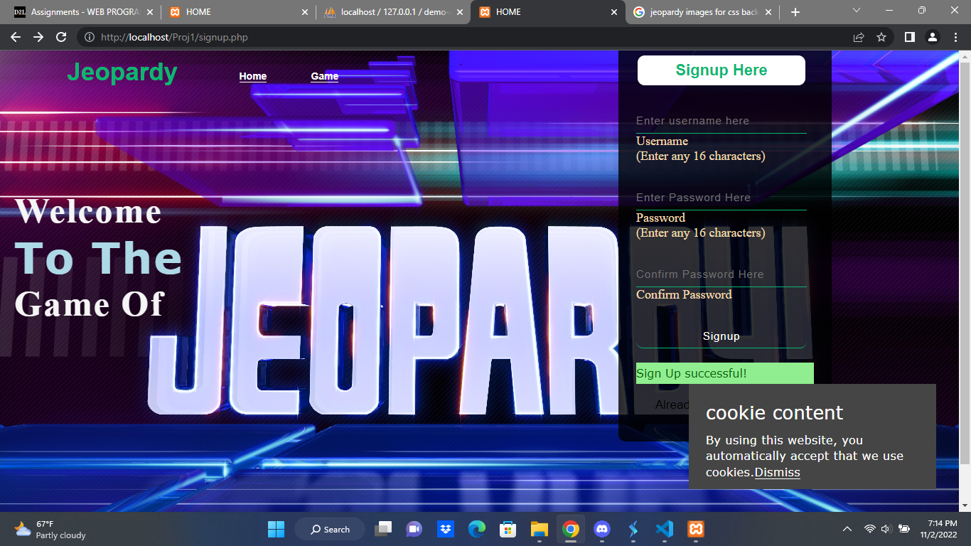
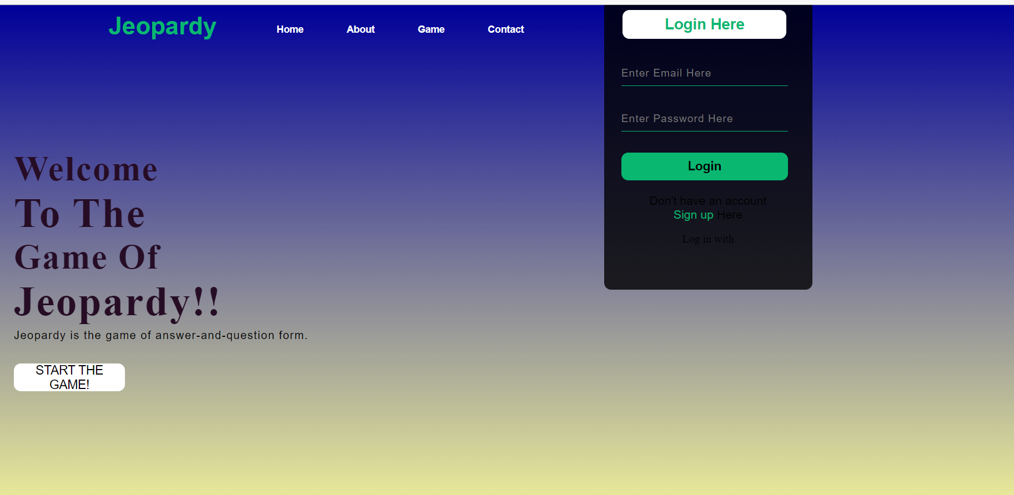

Slide 7
Our home page creates a welcoming landing spot for players both seasoned and new. With an open layout and easy to read fonts and colors anyone can easily figure out how to get started. It also features cookies quick navigation tools.

Slide 8
<?php
$dont_show_error = true;;
setcookie("games", "quiz games", time() + 86400, "/");
if ($_SERVER['REQUEST_METHOD'] == "POST") {
include '_dbconnect.php';
$GLOBALS['login_sucess'] = false;
$username = $_POST['username'];
$password = $_POST['password'];
$sql = "SELECT * from `demo-registration`.`credentials` where username='$username'";
$result = mysqli_query($conn, $sql);
$num = mysqli_num_rows($result);
if ($num == 1){
while ($row = mysqli_fetch_assoc($result)){
if (password_verify($password, $row['password'])){
session_start();
$_SESSION['loggedin'] = true;
$_SESSION['username'] = $username;
$sql = "INSERT INTO `demo-registration`.`user_points` (`id`, `username`, `score`) VALUES (NULL, '$username', 0)";
$result = mysqli_query($conn, $sql);
header("location: jeopardy_board.php");

Slide 9
}else{
$dont_show_error = false;
}
}
}
}
?>
<!DOCTYPE html>
<html>
<head>
<meta charset="utf-8">
<meta name="viewport" content="width=device-width, initial-scale=1">
<title>HOME</title>
<link rel="stylesheet" href="credentials.css">
</head>
<body>
<div class="main">
<div class="navbar">
<div class="icon">
<h2 class="logo">Jeopardy</h2>
</div>
<div class="menu">

Slide 10
<ul style="list-style: none;">
<li><a href="welcome.php">Home</a></li>
<li> <a href="jeopardy_board.php">Game</a></li>
</ul>
</div>
</div>
<div class="content">
<h1> Welcome <br><span> To The </span> <br>Game Of</h1>
<div class="form">
<h2>Login Here</h2>
<form action="welcome.php" method="POST">
<label for="username"></label>
<input type="text" name="username" placeholder="Enter username here" id="username" maxlength="16" required>
<p class="form-element">Username<br>(Enter any 16 characters)</p>
<label for="password"></label>
<input type="password" placeholder="Enter Password Here" name="password" id="password" maxlength="16" required>
<p class="form-element">Password<br>(Enter any 16 characters)</p>
<input type="submit" class="btnn" value="login">
<?php
if($dont_show_error == false){
echo "<p class='errormessage'> Invalid credentials</p>";
}

Slide 11
?>
</form><br>
<p class="link">Don't have an account?<br>
<a href="signup.php">Sign up Here</a>
</p>
</div>
</div>
<div class="cookies-card">
<p class="title">cookie content</p>
<p class="info">By using this website, you automatically accept that we use cookies. <a href="#">Dismiss</a></p>
</div>
</body>
</html>

Slide 12
Data Base Connections

Slide 13
<?php
$username = "root";
$password ="";
$server= "localhost";
$conn = mysqli_connect($server, $username, $password);
if(!$conn){
die("Could not connect to server " . mysqli_connect_error());
}
$sql = "CREATE DATABASE IF NOT EXISTS `demo-registration`";
mysqli_query($conn, $sql);
$sql = "CREATE TABLE IF NOT EXISTS `demo-registration`.`credentials` (`id` INT NOT NULL AUTO_INCREMENT , `username` VARCHAR(16) NOT NULL , `password` VARCHAR(255) NOT NULL , `date` DATETIME NOT NULL DEFAULT CURRENT_TIMESTAMP , PRIMARY KEY (`id`)) ENGINE = InnoDB;";
mysqli_query($conn, $sql);
$sql = "ALTER TABLE `demo-registration`.`credentials` ADD UNIQUE(`username`)";
mysqli_query($conn, $sql);
$sql = "CREATE TABLE IF NOT EXISTS `demo-registration`.`user_points` (`id` INT NOT NULL AUTO_INCREMENT , `username` VARCHAR(16) NOT NULL , `score` INT NOT NULL , PRIMARY KEY (`id`)) ENGINE = InnoDB;";
mysqli_query($conn, $sql);
?>

Slide 14
Game Board

Slide 15
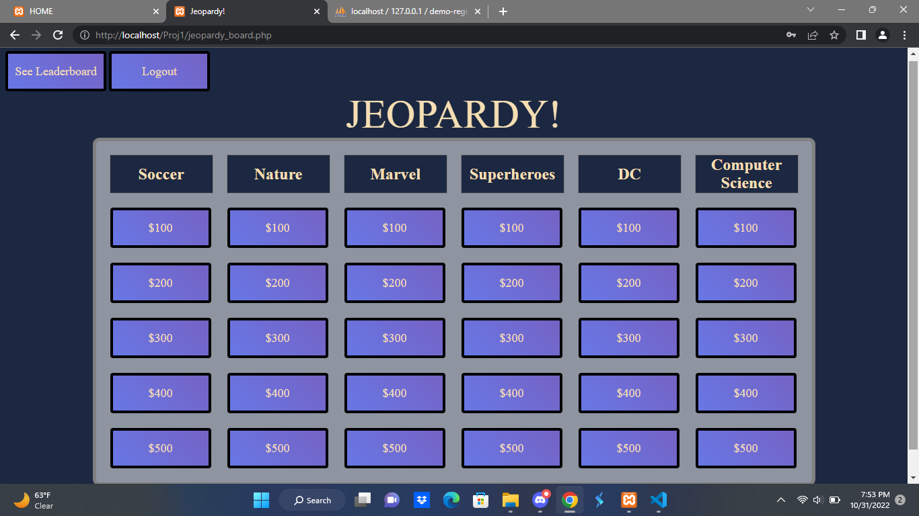

Slide 16
The Board supports 6 categories with 5 questions each at varying levels of difficulty and reward if correct or penalty if incorrect. It has many features with interactive buttons and transformations. Also links to the Leader Board and Logout pages.

Slide 17
<!DOCTYPE html>
<html lang="en">
<head>
<meta charset="UTF-8">
<meta http-equiv="X-UA-Compatible" content="IE=edge">
<meta name="viewport" content="width=device-width, initial-scale=1.0">
<title>Jeopardy!</title>
<link rel="stylesheet" href="jeopardy_boardStyle.css">
<body>
<table CELLSPACING=8>
<caption>
<h1 id="cap-style">JEOPARDY!</h1>
</caption>
<tr>
<th>Soccer</th>
<th>Nature</th>
<th>Marvel</th>
<th>Superheroes</th>
<th>DC</th>
<th>Computer Science</th>
</tr>

Slide 18
<td class="button"><a href="cs_300.php">$300</a></td>
</tr>
<tr>
<td class="button"><a href="soccer_400.php">$400</a></td>
<td class="button"><a href="nature_400.php">$400</a></td>
<td class="button"><a href="marvel_400.php">$400</a></td>
<td class="button"><a href="Superheroes_400.php">$400</a></td>
<td class="button"><a href="DC_400.php">$400</a></td>
<td class="button"><a href="cs_400.php">$400</a></td>
</tr>
<tr>
<td class="button"><a href="soccer_500.php">$500</a></td>
<td class="button"><a href="nature_500.php">$500</a></td>
<td class="button"><a href="marvel_500.php">$500</a></td>
<td class="button"><a href="Superheroes_500.php">$500</a></td>
<td class="button"><a href="DC_500.php">$500</a></td>
<td class="button"><a href="cs_500.php">$500</a></td>
</tr>
</body>
</html>

Slide 19
Sign Up Page

Slide 20
The sign up page will allow anyone to either login with their preferred email and password or create a new account with that information. They can also attempt to recover a forgotten password and agree to terms and conditions of privacy.

Slide 21
<!DOCTYPE html>
<html>
<link rel="stylesheet" href="sign_up.css">
<form action="action_page.php" method="post" style="border:1px solid #ccc">
<div class="container">
<h1>Login</h1>
<label for="uname"><b>Username</b></label>
<input type="text" placeholder="Enter Username" name="uname" required>
<label for="psw"><b>Password</b></label>
<input type="password" placeholder="Enter Password" name="psw" required>
<button type="submit">Login</button>
<label>
<input type="checkbox" checked="checked" name="remember"> Remember me
</label>

Slide 22
<p></p>
</div>
<div class="container" style="background-color:#f1f1f1">
<button type="button" class="cancelbtn">Cancel</button>
<span class="psw">Forgot <a href="#">password?</a></span>
</div>
</form>
<p></p>
<form action="action_page.php" style="border:1px solid #ccc">
<div class="container">
<h1>Sign Up</h1>
<p>Create an account.</p>
<hr>
<label for="email"><b>Email</b></label>
<input type="text" placeholder="Enter Email" name="email" required>
<label for="psw"><b>Password</b></label>
<input type="password" placeholder="Enter Password" name="psw" required>

Slide 23
<label for="psw-repeat"><b>Repeat Password</b></label>
<input type="password" placeholder="Repeat Password" name="psw-repeat" required>
<label>
<input type="checkbox" checked="checked" name="remember" style="margin-bottom:15px"> Remember me
</label>
<p>By creating an account you agree to our <a href="#" style="color:dodgerblue">Terms & Privacy</a>.</p>
<div class="clearfix">
<button type="button" class="cancelbtn">Cancel</button>
<button type="submit" class="signupbtn">Sign Up</button>
</div>
</div>
</form>
</html>

Slide 24
Questions? & Answers!

Slide 25
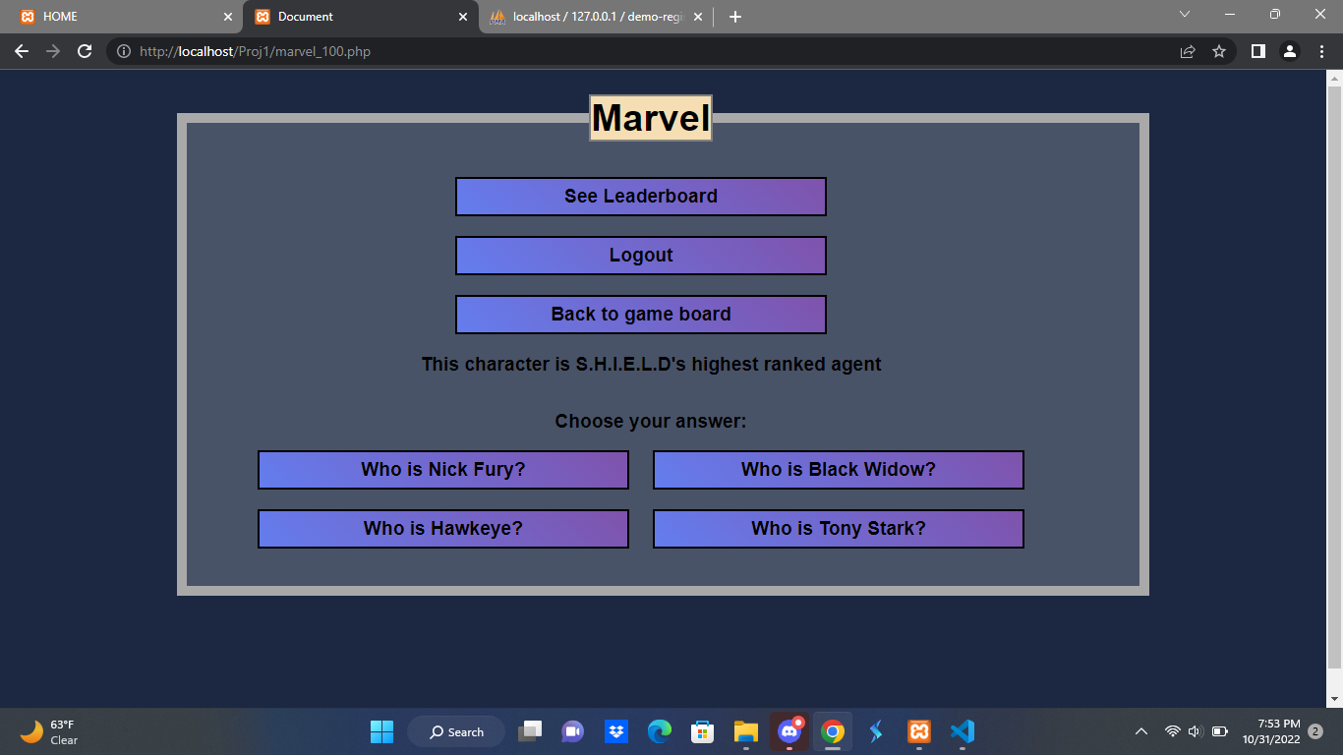

Slide 26
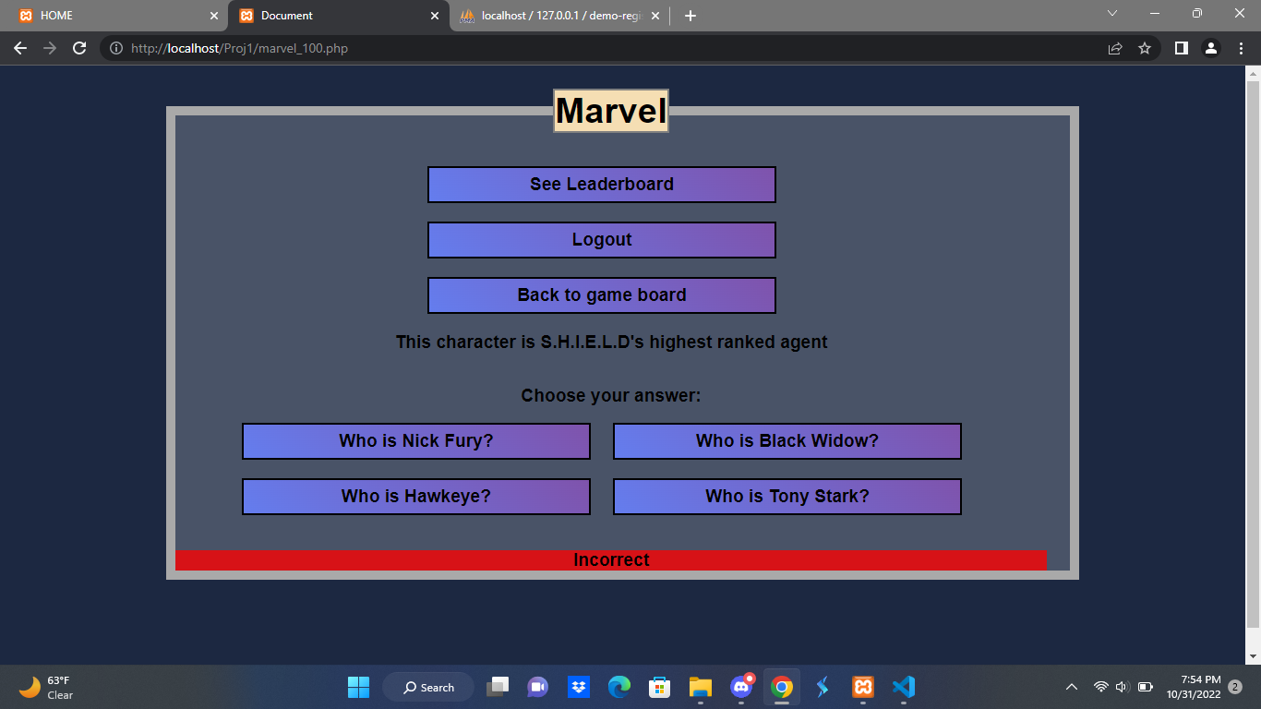

Slide 27
<?php
session_start();
include '_dbconnect.php';
?>
<!DOCTYPE html>
<html lang="en">
<head>
<meta charset="UTF-8">
<meta http-equiv="X-UA-Compatible" content="IE=edge">
<meta name="viewport" content="width=device-width, initial-scale=1.0">
<title>Document</title>
<link rel="stylesheet" href="questions_answers.css">
</head>
<body>
<div>
<fieldset>
<legend><h1 class="category">Marvel</h1></legend>
<br><br>
<a href="leaderboard.php"><input type="submit" value="See Leaderboard"></a><br>
<a href="logout.php"><input type="submit" value="Logout"></a><br>
<a href="jeopardy_board.php"> <input type="submit" value="Back to game board"></a>
<p>This character is S.H.I.E.L.D's highest ranked agent</p><br><br>
<form action="<?php echo htmlspecialchars($_SERVER["PHP_SELF"]);?>" method="post">
<label for="MV1">Choose your answer:</label><br><br>
<input type="submit" name="mv1" id="MV1" value="Who is Nick Fury?">
<input type="submit" name="mv1" id="MV1" value="Who is Black Widow?">
<input type="submit" name="mv1" id="MV1" value="Who is Hawkeye?">
<input type="submit" name="mv1" id="MV1" value="Who is Tony Stark?"><br><br>
</form>
<?php
if(isset($_POST['mv1'])){
$answer = $_POST['mv1'];
if((strcmp($answer, "Who is Nick Fury?"))==0){
$sql = "UPDATE `user_points` SET score = score + 100";
mysqli_query($conn, $sql);
echo "<div class='right-wrong'>";
echo "<p class='correct'>Correct</p>";
echo "</div>";
}else{
echo "<div class='right-wrong'>";
echo "<p class='wrong'>Incorrect</p>";
echo "</div>";
}
}?>
</fieldset>
</div>
</body>
</html>

Slide 28
Leader Board

Slide 29
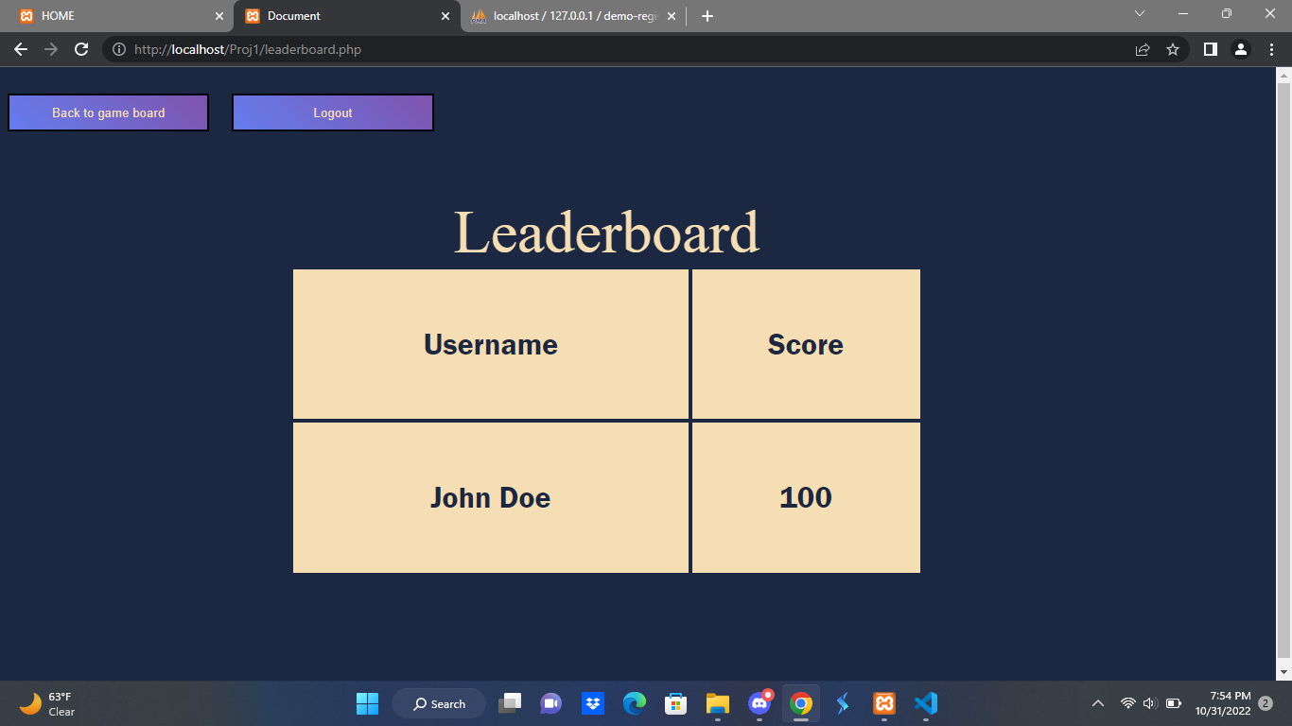

Slide 30
<a href="jeopardy_board.php"> <input type="submit" value="Back to game board"></a>
<p>Name a career of Mysterio before he chose to go with the life of crime.</p><br><br>
<form action="<?php echo htmlspecialchars($_SERVER["PHP_SELF"]);?>" method="post">
<label for="MV4">Choose your answer:</label><br><br>
<input type="submit" name="mv4" id="MV4" value="What is an actor?">
<input type="submit" name="mv4" id="MV4" value="What is a doctor?">
<input type="submit" name="mv4" id="MV4" value="What is a pilot?">
<input type="submit" name="mv4" id="MV4" value="What is a mailman?"><br><br>
</form>
<?php
if(isset($_POST['mv4'])){
$answer = $_POST['mv4'];
if((strcmp($answer, "What is an actor?"))==0){
$sql = "UPDATE `user_points` SET score = score + 100";
mysqli_query($conn, $sql);
echo "<div class='right-wrong'>";
echo "<p class='correct'>Correct</p>";
echo "</div>";
}else{
echo "<div class='right-wrong'>";
echo "<p class='wrong'>Incorrect</p>";
echo "</div>";
}
}?>
</fieldset>
</div>
</body>
</html>
<?php
session_start();
include '_dbconnect.php';
?>
<!DOCTYPE html>
<html lang="en">
<head>
<meta charset="UTF-8">
<meta http-equiv="X-UA-Compatible" content="IE=edge">
<meta name="viewport" content="width=device-width, initial-scale=1.0">
<title>Document</title>
<link rel="stylesheet" href="questions_answers.css">
</head>
<body>
<div>
<fieldset>
<legend><h1 class="category">Marvel</h1></legend>
<br><br>
<a href="leaderboard.php"><input type="submit" value="See Leaderboard"></a><br>
<a href="logout.php"><input type="submit" value="Logout"></a><br>

Slide 31
The game in action!

Slide 32
Thank you!

